Slide 1


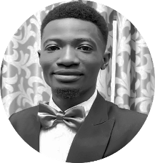

Ankat Anny Tohomdet – Analyst
Professional experience
Professional experience (cont’d)
Africa Foresight Group
Cost-efficiency of extension approaches on the example of RAS in Plateau State Nigeria (potato value chain)
Ankat serves as a consultant for Africa Foresight Group and has worked on the following project
Served as a Field researcher for Project Champion
Worked with AFG’S team on Project Donald Duck
Supported the lead researcher on Project Hedge stone
Worked on the assessment of Nigeria's Political Landscape for 2019 election for AFG
Has provided advisory and technical support to other projects
Ankat serves as a part time Research Data analyst with the Institute of African Intelligence preforming 80% of his task remotely
Research data enumeration, analysis and presentation
Organizational administration and strategic planning/implementation
Digital marketing and strategic communication
Ankat is an Administrative Officer with a zonal office of the National Bureau Of Statistics Nigeria
Field data enumeration
Data entry and processing
Office administration and Personnel Management
Ankat spent 3 years as a Human Resource and Communications Assistant at the Institute Of Human Virology, Nigeria
Human resource management
Strategic communication
Office administration and team support
Education and skills
Ankat holds an M.Sc. Public Policy Analysis from NSUK and an MPA from the NOUN all in Nigeria.
He hold a B.Sc. Political Science from Covenant University Nigeria
Ankat is also an M.Phil./PhD. candidate with the University Of Jos Nigeria
He speaks English and Hausa
Introduction
Ankat has worked for more than 5 years with both governmental and non-governmental organizations. He has held various positions where he performed various administrative and research tasks, while developing his skill set and capacity for better service delivery.

